Slide 1
Inheritance,Interfaces,Packages

Slide 2
Ms. Priti P.Bokariya
Lecturer, Computer Engineering dept.
SBMP

Slide 3
Inheritance Basics
Java, Inheritance is an important pillar of OOP(Object-Oriented Programming). It is the mechanism in Java by which one class is allowed to inherit the features(fields and methods) of another class.
In Java, Inheritance means creating new classes based on existing classes.
A class that inherits from another class can reuse the methods and fields of that class.
In addition, you can add new fields and methods to your current class as well.

Slide 4
Need Java Inheritance
Code Reusability: The code written in the Superclass is common to all subclasses. Child classes can directly use the parent class code.
Method Overriding: Method Overriding is achievable only through Inheritance. It is one of the ways by which Java achieves Run Time Polymorphism.
Polymorphism:

Slide 5
Terms used in Inheritance
Class: A class is a group of objects which have common properties. It is a template or blueprint from which objects are created.
Sub Class/Child Class: Subclass is a class which inherits the other class. It is also called a derived class, extended class, or child class.
Super Class/Parent Class: Superclass is the class from where a subclass inherits the features. It is also called a base class or a parent class.
Reusability: As the name specifies, reusability is a mechanism which facilitates you to reuse the fields and methods of the existing class when you create a new class. You can use the same fields and methods already defined in the previous class.

Slide 6
syntax of Java Inheritance
class Subclass-name extends Superclass-name
{
//methods and fields
}
The extends keyword indicates that you are making a new class that derives from an existing class. The meaning of "extends" is to increase the functionality.
In the terminology of Java, a class which is inherited is called a parent or superclass, and the new class is called child or subclass.

Slide 7
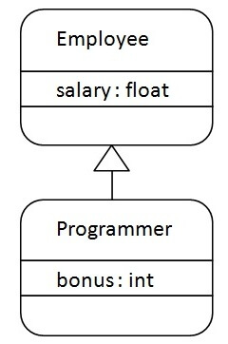
Java Inheritance Example
Programmer is the subclass and Employee is the superclass. The relationship between the two classes is Programmer IS-A Employee.
It means that Programmer is a type of Employee.
extends

Slide 8
class Employee
{
float salary=40000;
}
class Programmer extends Employee
{
int bonus=10000;
public static void main(String args[])
{
Programmer p=new Programmer();
System.out.println("Programmer salary is:"+p.salary);
System.out.println("Bonus of Programmer is:"+p.bonus);
}
}
In the above example, Programmer object can access the field of own class as well as of Employee class i.e. code reusability.

Slide 9
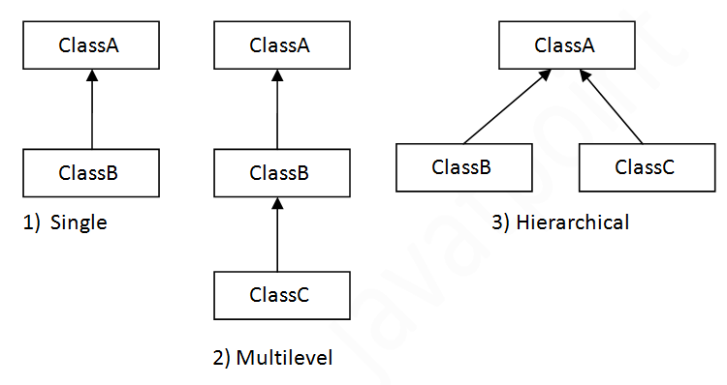

Types of Inheritance
On the basis of class, there can be three types of inheritance in java: single, multilevel and hierarchical.

Slide 10
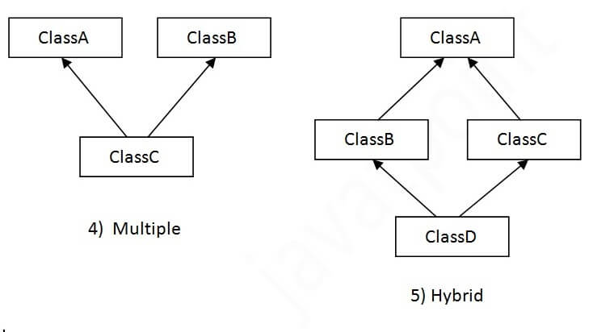
When one class inherits multiple classes, it is known as multiple inheritance.
Multiple inheritance is not supported in Java through class.

Slide 11

Single Inheritance
When a class inherits another class, it is known as a single inheritance. In the example given below, Student class inherits the Person class, so there is the single inheritance.
Person
Student

Slide 12
public class Person
{
protected String name;
protected int age; public Person(String name, int age)
{
this.name = name;
this.age = age;
} public void display ()
{
System.out.println("Name: " + name + ", Age: " + age);
}
}
public class Student extends Person {
private String studentId;
private float percentage;
public Student(String name, int age, String studentId, float percentage) {
super(name, age);//Person class constructor is called/invoked
this.studentId = studentId;
this.percentage = percentage;
} public void displayInfo() {
System.out.println("Student ID: " + studentId + ", Percentage: " + percentage);
}
}

Slide 13
public class InheritMain{
public static void main(String[] args) {
Person p = new Person("xyz", 30);
Student s = new Student("abc", 20, "S12345", 87.90);
System.out.println("Person Info:");
p.display();
System.out.println("\nStudent Info:");
s.display(); //display method of Person class can be invoked by object of student class
s.displayInfo();
}
}
Student Object
name
age
studentId
percentage
display()
displayInfo()
Data members name,age and method display() is inherited from Person class
s

Slide 14
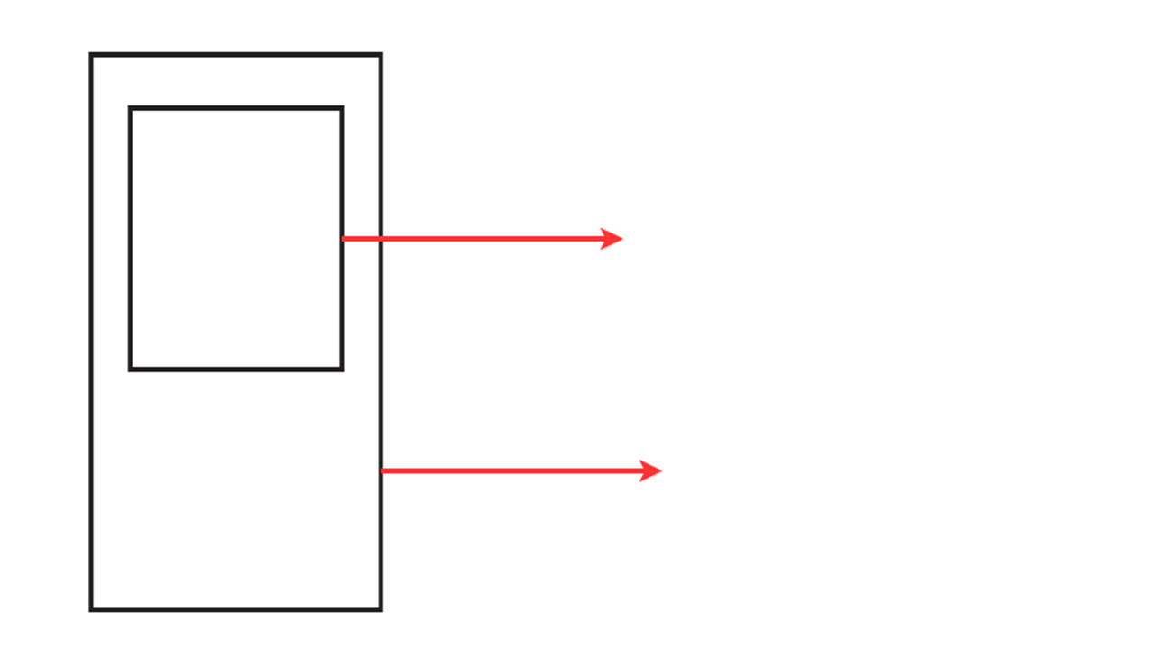
name
age
display()
Copy of data fields and methods of Person class in Student object
studentId
percentage
displayInfo()
Object of Student class
Student object

Slide 15
Multilevel Inheritance
Multilevel hierarchy, or multilevel inheritance, in Java is a type of inheritance where a class is derived from another derived class.
This creates a chain of inheritance, with each class inheriting properties and behaviors from its parent class. Here's a detailed explanation and example to illustrate this concept:
Person
Explanation
In a multilevel hierarchy:
Base Class (Parent): The topmost class from which other classes inherit. Person class is the Base class as shown in the figure.
Intermediate Class (Child): A class that inherits from the base class and serves as a parent class for another class .For eg. Employee
Derived Class (Grandchild): A class that inherits from the intermediate class. For eg. Manager
Employee
Manager

Slide 16
// Base Class
class Person {
String name;
int age;
public Person(String name, int age) {
this.name = name;
this.age = age;
}
public void display() {
System.out.println("Name: " + name);
System.out.println("Age: " + age);
}
} // Intermediate Class
class Employee extends Person {
String employeeId;
public Employee(String name, int age, String employeeId) {
super(name, age);
this.employeeId = employeeId;
}
public void display() {
super.display();
System.out.println("Employee ID: " + employeeId);
}
}

Slide 17
// Derived Class
class Manager extends Employee {
String department;
public Manager(String name, int age, String employeeId, String department)
{
super(name, age, employeeId);
this.department = department;
}
public void display()
{
super.display();
System.out.println("Department: " + department);
}
} // Main Class
public class MultilevelInheritance
{
public static void main(String[] args) {
Manager mgr = new Manager(“xyz", 35, "E12345", "Sales");
mgr.display();
}
}

Slide 18
Hierarchical Inheritance
Hierarchical inheritance in Java is a type of inheritance where multiple classes inherit from a single parent class.
This creates a tree-like structure with the base class as the root and the derived classes as the branches.
Explanation
In hierarchical inheritance:
Base Class (Parent): The topmost class from which other classes inherit.
Derived Classes (Children): Multiple classes that inherit from the same base

Slide 19
Example
Let's consider an example with one base class, Person, and two derived classes, Student and Faculty.
Person: The base class
Student: Inherits from Person
Faculty: Also inherits from Person.
Person
Student
Faculty

Slide 20
/ Base Class
class Person {
String name;
int age;
public Person(String name, int age) {
this.name = name;
this.age = age;
}
public void display() {
System.out.println("Name: " + name);
System.out.println("Age: " + age);
}
// Derived Class 1
class Student extends Person {
String studentId;
public Student(String name, int age, String studentId) {
super(name, age);
this.studentId = studentId;
}
public void display() {
super.display();
System.out.println("Student ID: " + studentId);
}
}

Slide 21
// Derived Class 2
class Faculty extends Person {
String facultyId;
public Faculty(String name, int age, String facultyId) {
super(name, age);
this.facultyId = facultyId;
}
public void display() {
super.display();
System.out.println("Faculty ID: " + facultyId);
}
}
// Main Class
public class HierarchicalInheritance {
public static void main(String[] args) {
Student student = new Student(“ABC", 20, "S12345");
Faculty faculty = new Faculty(“XYZ", 45, "F67890");
System.out.println("Student Details:");
student.display();
System.out.println("\nFaculty Details:");
faculty.display();
}
}

Slide 22
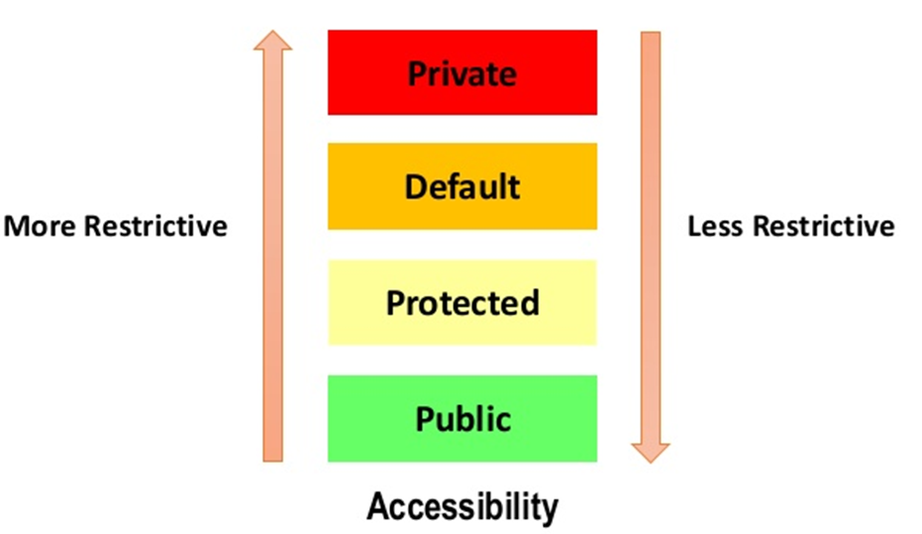
Member Access and Inheritance
Access Modifiers
private: Members are accessible only within the same class.
protected: Members are accessible within the same package and by subclasses.
public: Members are accessible from any other class in any package
default (no modifier): Members are accessible only within the same package.

Slide 23
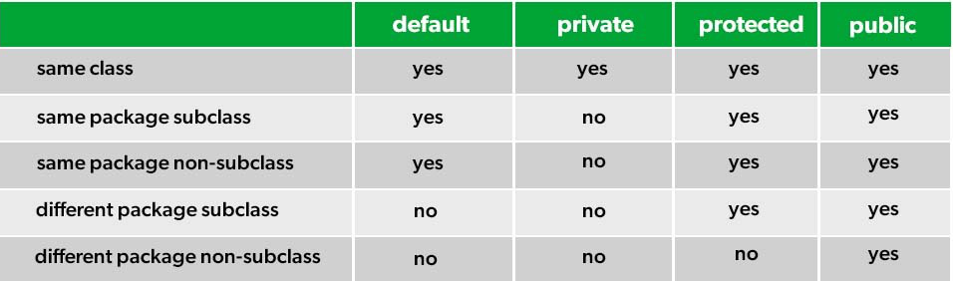

Slide 24
Example of Access Modifiers
public class Person {
private String name;
private int age;
protected String address; // Protected member
public String phoneNumber; // Public member
public Person(String name, int age, String address, String phoneNumber) {
this.name = name;
this.age = age;
this.Address = address;
this.phoneNumber = phoneNumber;
}
public void displayInfo() {
System.out.println("Name: " + name + ", Age: " + age + ", Address: " + address + ", Phone: " + phoneNumber);
}
}

Slide 25
Superclass Variable can reference a Subclass Object
When a superclass variable references a subclass object, it means that the variable is of the type of the superclass, but it points to an object that is an instance of the subclass. This is a fundamental concept in object-oriented programming, known as polymorphism.
Person
Person p= new Student();
extends
Superclass Variable
Subclass Object
Student

Slide 26
Dynamic Method Dispatch
Dynamic method dispatch (also known as runtime polymorphism) is a crucial concept in Java. It allows a call to an overridden method to be resolved at runtime rather than compile time.
When an overridden method is called through a superclass reference, Java determines which version (superclass or subclass) of that method to execute based on the type of the object being referred to at runtime.
The decision is made dynamically, depending on the actual object type (not the reference type).
This allows for flexibility and polymorphism.

Slide 27
class A {
void m1() {
System.out.println("Inside A's m1 method");
}
}
class B extends A {
void m1() {
System.out.println("Inside B's m1 method");
}
}
class C extends A {
void m1() {
System.out.println("Inside C's m1 method");
}
}
public class Dispatch {
public static void main(String[] args) {
A a = new A();
B b = new B();
C c = new C();
A ref;
ref = a;
ref.m1(); // Calls A's version of m1()
ref = b;
ref.m1(); // Calls B's version of m1()
ref = c;
ref.m1(); // Calls C's version of m1()
}
}

Slide 28
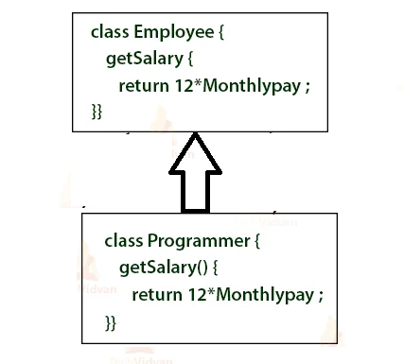
Method Overriding
If subclass (child class) has the same method as declared in the parent class, it is known as method overriding in Java.
Method overriding allows a subclass to provide a specific implementation of a method that is already defined in its superclass.

Slide 29
public class Student extends Person {
private String studentId;
private float percentage;
public Student(String name, int age, String studentId, float percentage) {
super(name, age);
this.studentId = studentId;
this.percentage = percentage;
}
@Override
public void display() {
super.display ();
System.out.println("Student ID: " + studentId + ", Percentage: " + percentage);
}
}
void display() (Overridden) in Derived class Student which is inherited from Base class Person

Slide 30
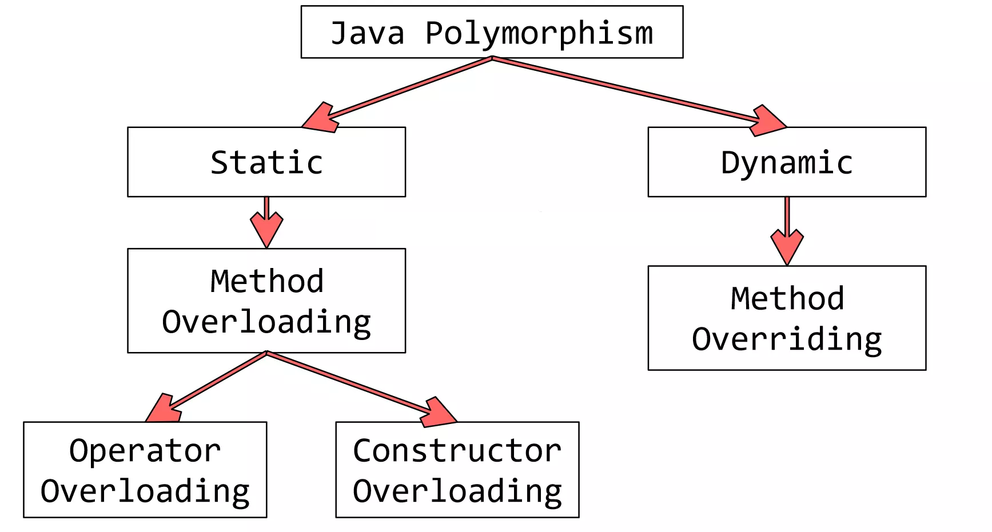


Polymorphism in java

